Slide 1
Edureka Project
Devops Certification Training
Name : Gadhi Sreenivasa Reddy

Slide 2
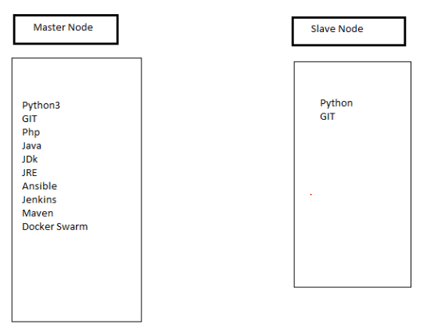
Requirements Needed
Created Two Ubuntu VM Instances using Google Cloud Platform(GCP).

Slide 3
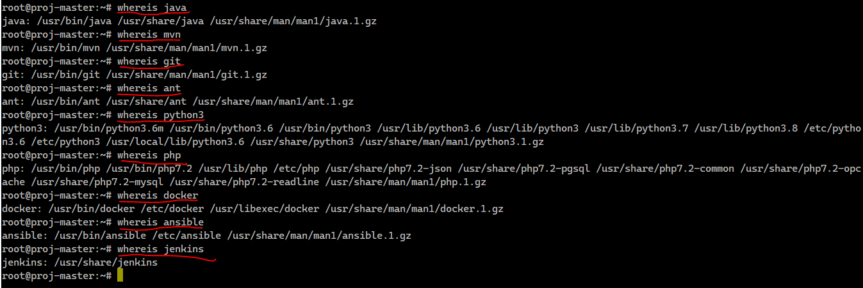
Installed Requirements

Slide 4
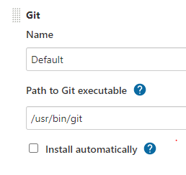
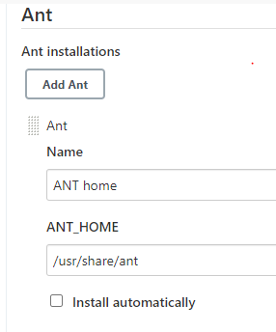
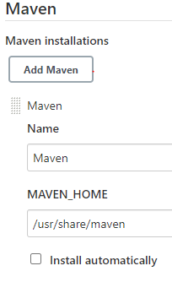
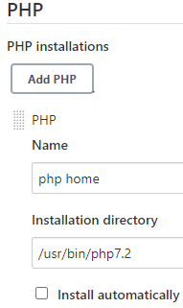
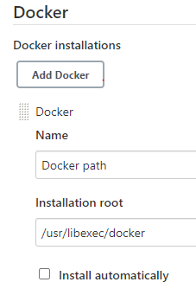
Adding Home path to Jenkins

Slide 5
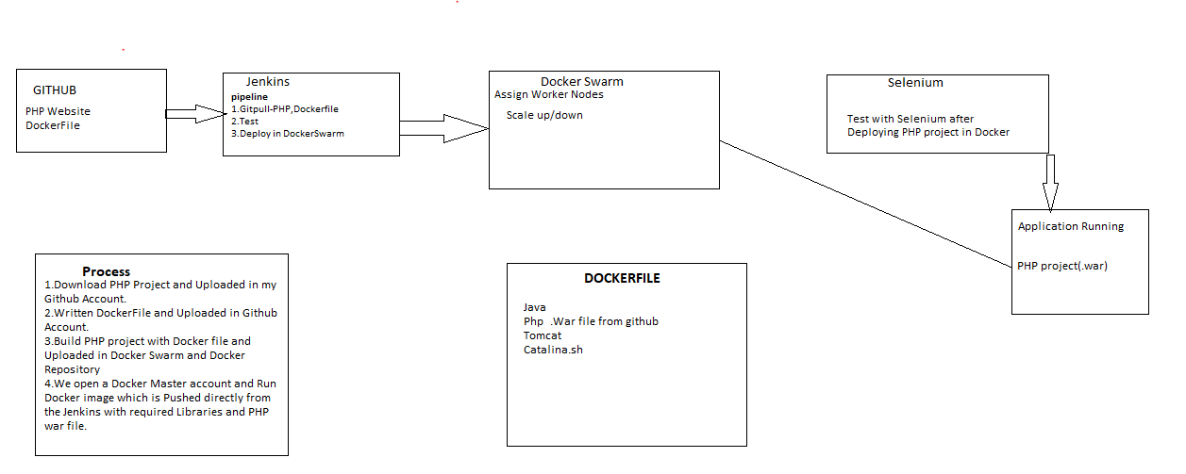
PROCESS

Slide 6
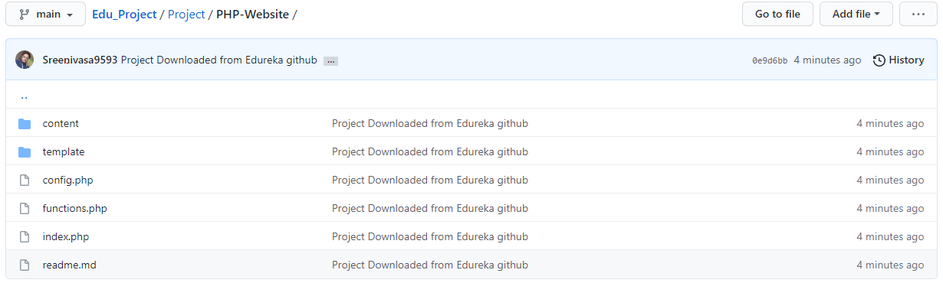
Uploaded PHP project in my Account

Slide 7
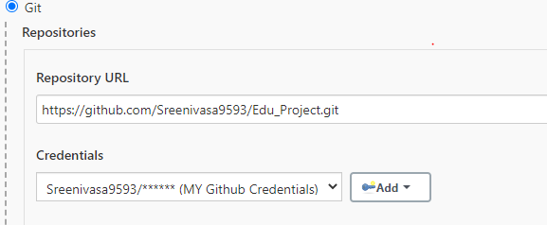
Git path and credentials

Slide 8
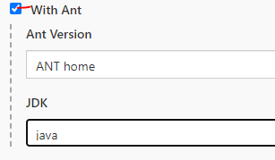
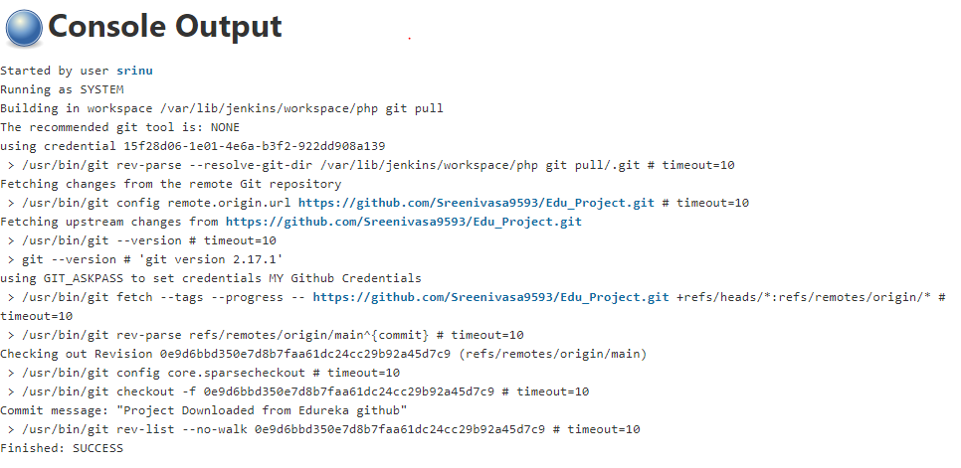
Build Environment

Slide 9
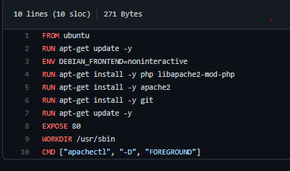
DockerFile creation and uploaded in my github account

Slide 10
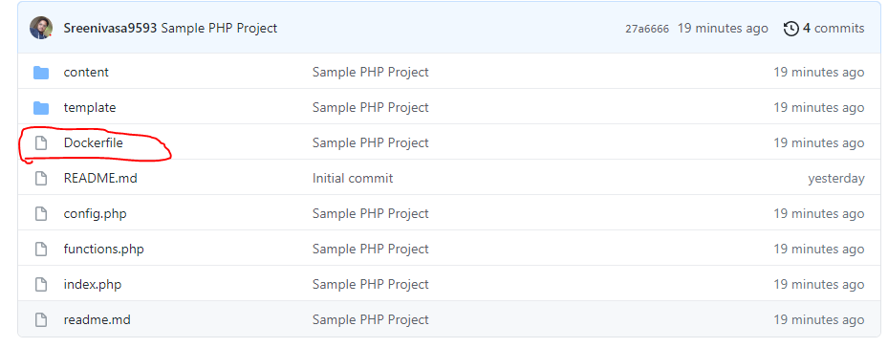

Slide 11
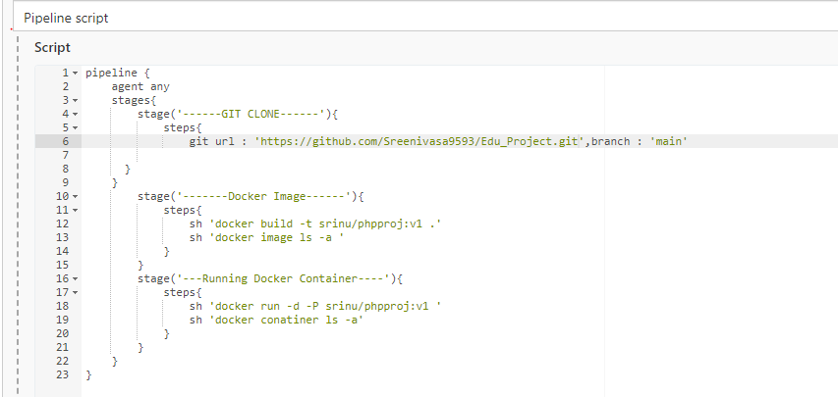
Jenkins Pipeline Script(groovy)

Slide 12
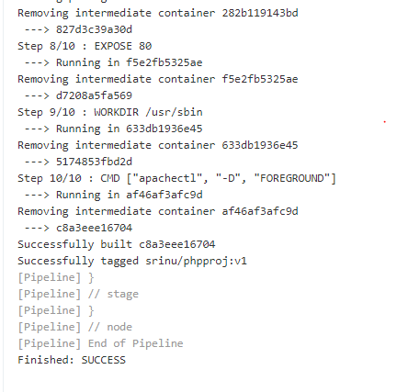

Slide 13
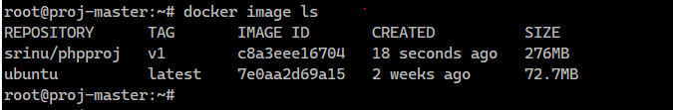
Docker Image is build in Vm Instance

Slide 14
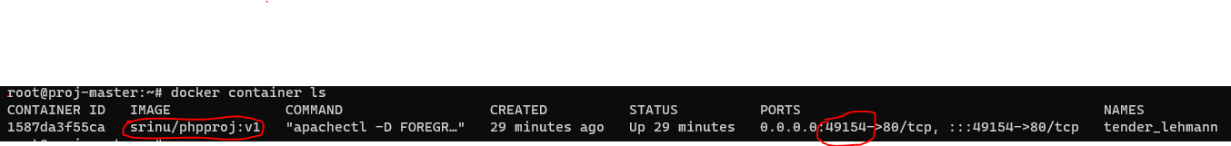
Running Docker image to form docker container
COMMANDS Used to Run Docker Image
docker image ls
docker run –d –P srinu/phpproj:v1
docker container ls
ports--49154 number opened in Browser

Slide 15
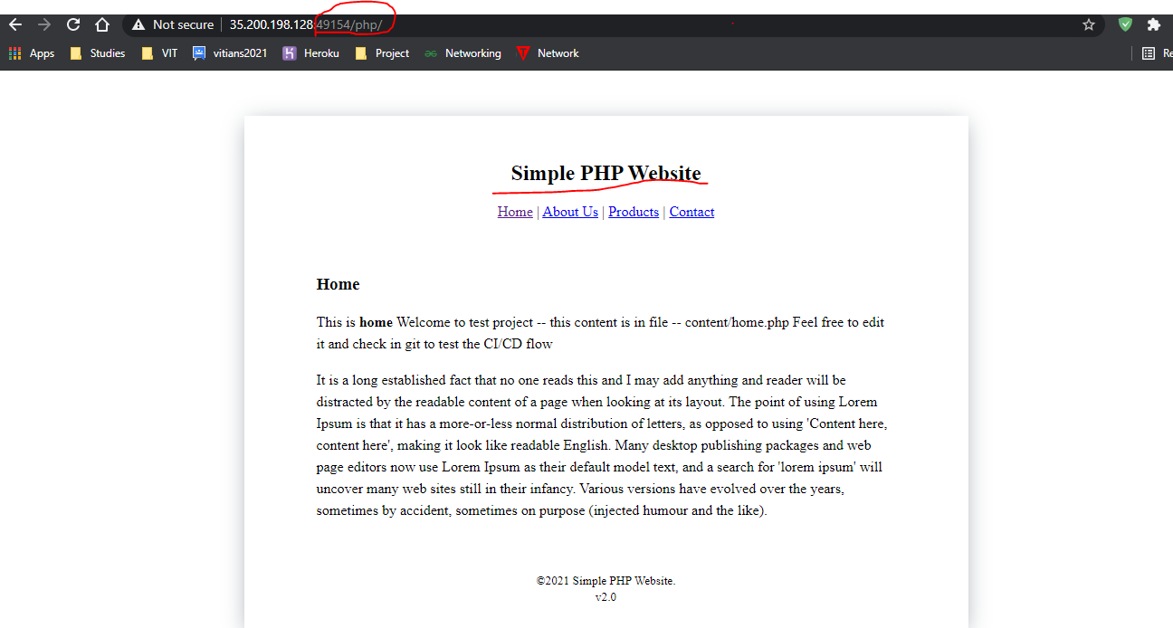

Slide 16


